Slide 1
Automated Diagnosis of Brain Pathologies Using Deep Learning and CT Images
Jeeva D
23MDT1049

Slide 2
OUTLINE
1
Aim
4
Methodology
2
Objective
5
Results and Conclusion
3
Review of Literature
6
Future Works

Slide 3
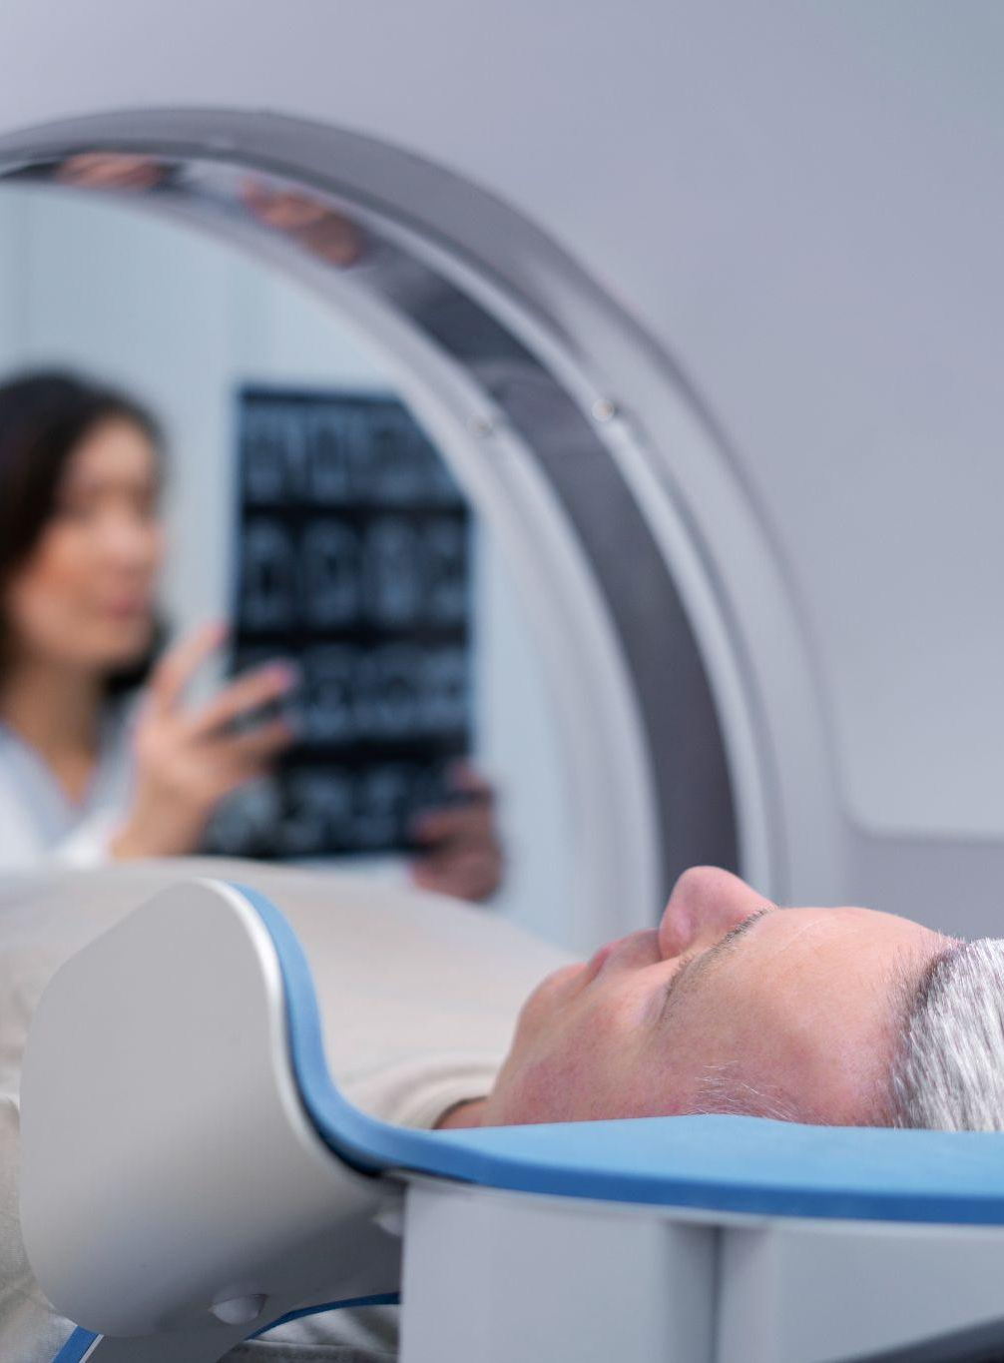
Aim To develop an automated deep learning-based diagnostic tool for accurately detecting brain pathologies such as tumors, cancer, and aneurysms from CT scan images, providing healthcare professionals with a reliable, efficient system to improve the speed and accuracy of diagnoses, ultimately enhancing patient outcomes.

Slide 4

Objective
To develop and apply deep learning algorithms for the automated diagnosis of brain pathologies, specifically tumors, cancer, and aneurysms, using CT scan images. The goal is to enhance the accuracy and efficiency of medical diagnoses to assist healthcare professionals in patient treatment.

Slide 5
Review of Literature
S.No | Paper Title | Author | Objective | Methodology | Conclusion
1 | Medical Image Classification Using Deep Learning | Seifedine Kadry et al. (2021) | To evaluate pre-trained deep learning models for brain MRI classification | Analyzed VGG16, VGG19, and ResNet50 models combined with SoftMax and SVM classifiers | Analyzed VGG16, VGG19, and ResNet50 models combined with SoftMax and SVM classifiers
2 | Deep Learning in Medical Image Analysis | Puttagunta M. & Ravi S. (2021) | To assess the impact of deep learning techniques in medical imaging | Reviewed CNN applications across X-rays, CT scans, mammograms, and histopathology | CNNs proved highly effective in disease detection, though data scarcity remains a challenge

Slide 6
S.No | Paper Title | Author | Objective | Methodology | Conclusion
3 | Brain Tumor Detection and Classification | Brain Tumor Detection and Classification | To evaluate machine learning techniques for brain tumor analysis | To evaluate machine learning techniques for brain tumor analysis | Deep learning models showed promising results but require quality training datasets
4 | Cancer Diagnosis Using Deep Learning | Munir K. et al. (2019) | To assess deep learning applications in cancer detection | Reviewed CNN architectures across different cancer types with focus on data balance | Equal representation of cases and multicrop pooling techniques improve diagnostic accuracy
5 | EfficientNet for Brain Tumor Classification | Hastomo W. et al. (2024) | To evaluate EfficientNet architecture for tumor detection | Compared EfficientNet B1/B2 with other CNN architectures | EfficientNet improved classification accuracy while reducing computational costs

Slide 7
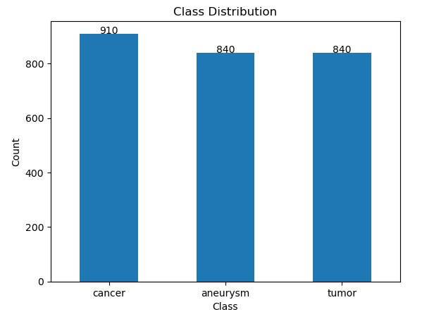
Methodology
About Dataset
EDA
The dataset includes labeled CT images representing three brain pathologies: aneurysms, cancer, and tumors. These labels provide the necessary ground truth for training machine learning models to detect each pathology. The diversity of the images across classes enhances the model’s ability to generalize across varied cases.

Slide 8
Data Preprocessing
Train Test Split
Training Set: Contains 1,554 entries for training the model. This set is used to optimize the model parameters.
Validation Set: Contains 129 entries to fine-tune model hyperparameters and help prevent overfitting.
Test Set: Contains 907 entries for final evaluation,
measuring model generalization on unseen data.
Image Resizing: All images are resized to 224x224 pixels for consistency with model input requirements.
Normalization: Pixel values are scaled to a 0-1 range by dividing by 255, improving model stability.
Data Augmentation: Random horizontal flips are applied during training to enhance model generalization by introducing varied perspectives.

Slide 9
Model Selection
VGG-16 Model Architecture
The model starts with a pre-trained VGG16 base (14,714,688 parameters)
Followed by 3 dense layer blocks, each consisting of a Dense layer, BatchNormalization, and Dropout(0.45)
Final Dense layer with 3 outputs using softmax activation for classification 4. Total model size is 56.13 MB with all parameters being trainable

Slide 10
Evaluation Metrices
VGG-16
precision recall f1-score support
aneurysm 1.00 0.05 0.09 299
cancer 0.55 0.44 0.49 313
tumor 0.46 1.00 0.63 295
accuracy 0.49 907
macro avg 0.67 0.50 0.40 907
weighted avg 0.67 0.49 0.40 907

Slide 11
ResNet-50
precision recall f1-score support
aneurysm 0.96 0.99 0.97 299
cancer 0.99 0.96 0.98 313
tumor 1.00 1.00 1.00 295
accuracy 0.98 907
macro avg 0.98 0.98 0.98 907
weighted avg 0.98 0.98 0.98 907

Slide 12
EfficientNet-B7
precision recall f1-score support
aneurysm 0.95 0.98 0.97 299
cancer 0.98 0.96 0.97 313
tumor 1.00 0.99 0.99 295
accuracy 0.98 907
macro avg 0.98 0.98 0.98 907
weighted avg 0.98 0.98 0.98 907

Slide 13
Results
VGG-16
Train Loss: 5.221975326538086 Train Accuracy: 0.4761904776096344
Validation Loss: 5.168546676635742 Validation Accuracy: 0.4883720874786377
Test Loss: 5.197704792022705 Test Accuracy: 0.49393606185913086
Resnet5
Train Loss: 6.8499298095703125 Train Accuracy: 0.993565022945404
Validation Loss: 6.904529571533203 Validation Accuracy: 0.9767441749572754
Test Loss: 6.8907952308654785 Test Accuracy: 0.9823594093322754
EfficientNet-B7
Train Loss: 7.4707350730896 Train Accuracy: 0.9929214715957642
Validation Loss: 7.52120304107666 Validation Accuracy: 0.9689922332763672
Test Loss: 7.505218505859375 Test Accuracy: 0.9757441878318787

Slide 14
Conclusion
Comparing the three models, VGG16 shows the poorest performance with a test accuracy of only 49.39%, indicating significant room for improvement. ResNet50 demonstrates the best performance with exceptional test accuracy of 98.23%, slightly outperforming EfficientNet-B7 which achieved 97.57% test accuracy. While both ResNet50 and EfficientNet-B7 show strong training accuracy (99.35% and 99.29% respectively), ResNet50’s higher validation and test accuracies suggest it has better generalization capability for this medical image classification task.

Slide 15
FUTURE WORKS
Building a hybrid model by incorporating parts of ResNet or EfficientNet into VGG16 is an advanced strategy. You might try this approach if simple architectural modifications don’t yield sufficient improvements.
Deploying the Model in Real-World Settings: Integrating the model into clinical software for real- time analysis and assisting healthcare professionals in diagnostics.
Implementing Explainable AI (XAI) Techniques: Applying techniques such as Grad-CAM or LIME to provide visual explanations for model predictions. This would help clinicians understand which areas of the CT scan contributed to the model’s decision, increasing trust and interpretability in clinical settings.

Slide 16
REFERENCES
1. Kadry, S., Nam, Y., Rauf, H. T., Rajinikanth, V., & Lawal, I. A. (2021).
2. Puttagunta, M., & Ravi, S. (2021).
3. Min, J., Sharif, M., Haldorai, A., Yasmin, M., & Nayak, R. S. (2022).
4. Munir, K., Elahi, H., Ayub, A., Frezza, F., & Rizzi, A. (2019).
5. Hastomo, W., Karno, A. S. B., Sestri, E., Terisia, V., Yusuf, D., Arman,
S. A., & Arif, D. (2024).

Slide 17
Thanks

